Slide 1
Thematic Analysis (TA) Day 1
Summer camp 2023
Presenters: Rashed & Mike

Slide 2
What is TA?
TA is a method for developing, analyzing and interpreting patterns across a qualitative dataset, which involves systematic processes of data coding to develop themes- themes are your ultimate analytic purpose.
TA is a method for data analysis rather than a methodology.
TA as method offer you a set of tools – concepts, techniques, practices, and guidelines – to organize, interrogate and interpret a dataset but using these well involve thinking and making choices, about other aspects of your research project and process.

Slide 3
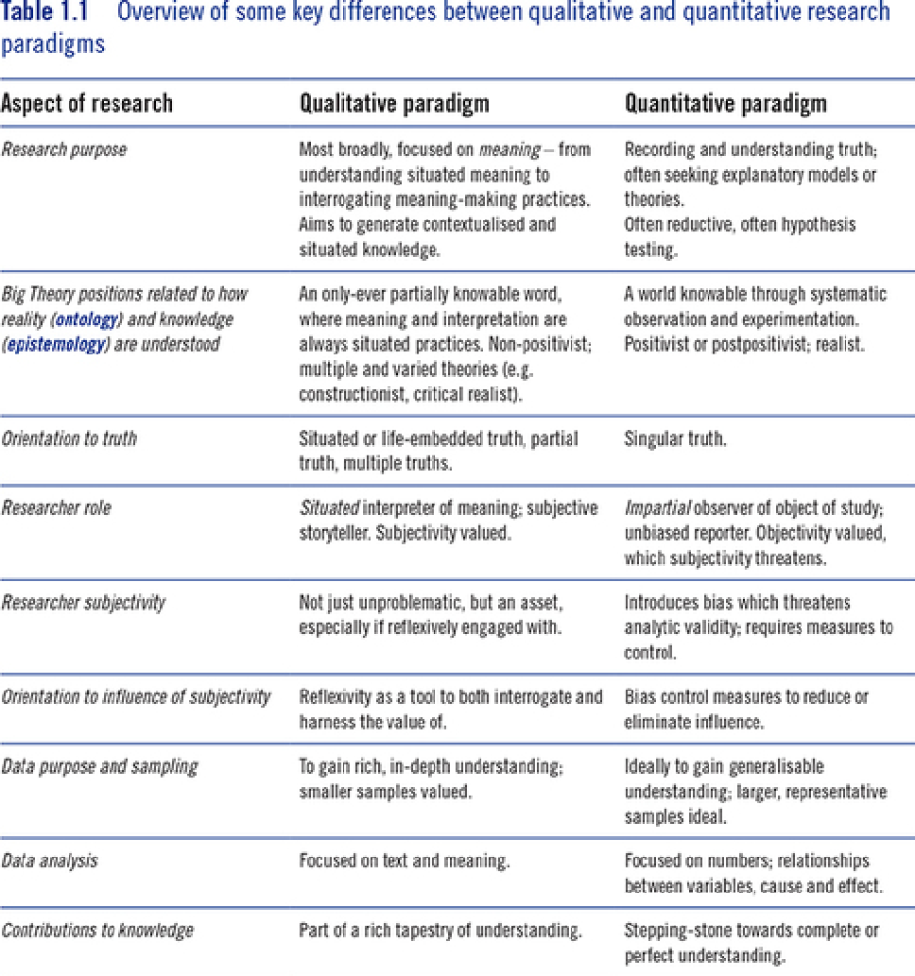
Differences between Qualitative and quantitative Research

Slide 4
What will you learn in this course
The analytical process of TA
Dataset familiarization (Day 1)
Data coding (Day 2)
Initial theme generation (Day 3)
Theme development and review (Day 3)
Theme refining and naming (Day 4)
Data visualization and results (Day 4)
Writing your thematic Analysis report (Day 5)
This is only the process not the method.

Slide 5
Qualitative Sensibility & Reflexive TA
a way to capture the values, assumptions, orientation and skills needed to conduct reflexive TA in a way aligned with a Big Q approach. (Big Q is ‘fully qualitative’ research. They contrasted this with the use of qualitative data in a limited way, or with values more aligned to quantitative positivist research – which they designated small q)
The certain orientations and skills critical to a qualitative sensibility :
An interest in process and meaning, over cause and effect;
A critical and questioning approach to life and knowledge;
The ability to reflect on the dominant assumptions embedded in your cultural context – being a cultural commentator as well as a cultural member;
The ability to read and listen to data actively and analytically – the development of an analytic orientation to data.
A desire for understanding that is about nuance, complexity and evencontradiction, rather than finding a nice tidy explanation – you like the long answer, not the short answer!;
The ability to embrace the idea that knowledge comes from a position, and adisinterest in the idea of a singular universal truth to be discovered;
The ability to tolerate some degree of uncertainty.

Slide 6
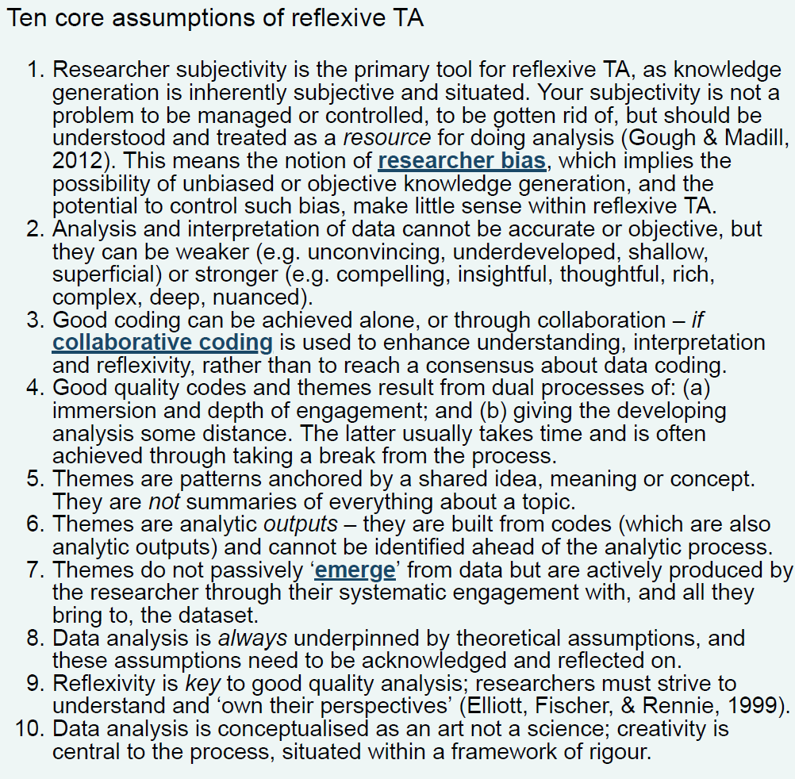
What is reflexive TA?

Slide 7
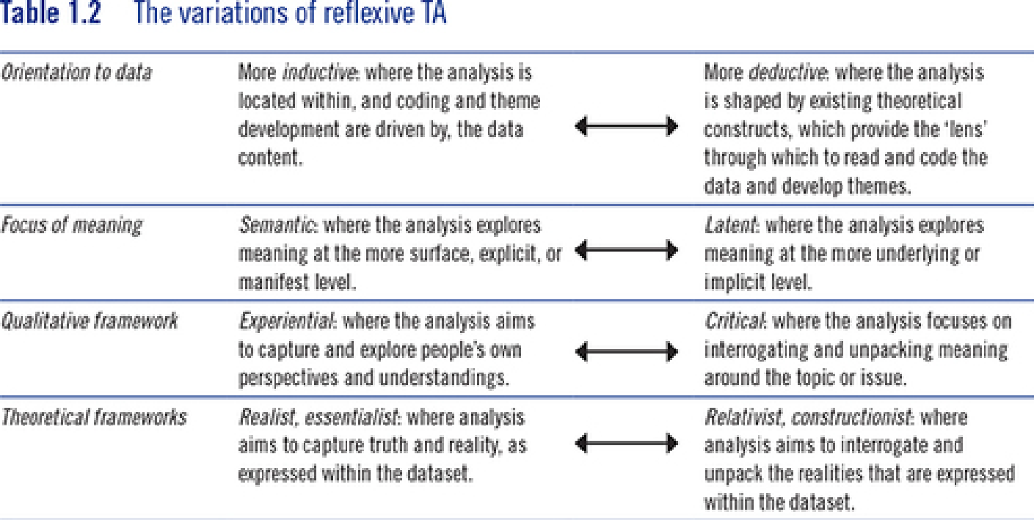

Slide 8
What to remember ?
You are the director of your analytic journey, the author of your analytic story Analysis happens at the intersection of the dataset, the context of the research, and researcher skill and locatedness. The aspiring reflexive TA researcher needs to imagine an adventure, where hidden pathways and surprising revelations, things which cannot be anticipated in advance, are part of the journey.

Slide 9
Before starting your TA- Research design
Conceptual coherence- as yourself whether your research aims and theoretical assumption and methodology cohere together? Is the data you are willing to collect answer your research question?
Research question is essential for design because it is your guide.
Flexible Dataset can be interviewing transcripts, diary entries, social media postings and open-source qualitative responses.
Systematic approach to data both when collected and analysed (data transformation).
Data Quality- you need to review and assess data collected. (is shallow, superficial?)
Data Flexible data set size and composition.
Datasize is subjective.

Slide 10
For more on Qualitative research design to use for Research
Creswell, J. W., & Poth, C. N. (2016). Qualitative inquiry and research design: Choosing among five approaches. London: Sage.
Patton, M. Q. (2015). Qualitative research and evaluating methods: Integrating theory and practice (4th ed.). Los Angeles, CA: Sage.
For interviews
Qualitative interviewing: Magnusson, E., & Marecek, J. (2015). Doing interview-based qualitative research: A learner’s guide. Cambridge: Cambridge University Press.
To read more about our critique of statistical models for determining ‘sample size’ in TA, see: Braun, V., & Clarke, V. (2016). (Mis)conceptualising themes, thematic analysis, and other problems with Fugard and Potts’ (2015) sample-size tool for thematic analysis. International Journal of Social Research Methodology, 19(6), 739–743.

Slide 11
Case study:Destigmatizing Chinese Communities in the face of COVID-19: Emergency Management
Actions to Address Social Vulnerability in Toronto and Nairobi
This study conducted remote interviews with participants in Toronto and Nairobi to explore how individuals in the Chinese diaspora community are coping and reacting to COVID-19. The interviews were conducted in English, Mandarin, and/or Cantonese and followed a semi-structured format. The purpose was to collect stories of experiences, study social impacts, and determine coping strategies applied during the pandemic. The data was coded to determine themes emerging from the data. The study was a quick response endeavor that collected perishable data between March 2020 and July 2020. This research contributes to the Government of Canada's global effort to address the public health challenges of the COVID-19 outbreak and has received ethics approval from various universities and organizations.

Slide 12
Beginning TA: Phase 1-Data Familiarization
Data Familiarization consists of 3 steps
1- The first is about developing deep and intimate knowledge of your dataset. This is often referred to as immersion.
2- The second is starting to critically engage with the information as data, rather than simply as information.
3- Your critical engagement can be facilitated by the third aspect of this phase – where you note ideas around the data that you have developed through familiarization.

Slide 13
activity
Page 50

Slide 14
Question to ask yourself?
How does the person make sense of whatever it is they are discussing?
Why might they be making sense of things in this way (and not in another way)?
In what different ways do they make sense of the topic?
How ‘common-sense’ or socially normative is this depiction or story?
How would I feel if I was in that situation? (Is this different from or similar to how the person feels, and why might that be?)
What assumptions do they make in describing the world?
What kind of world is ‘revealed’ through their account?

Slide 15
Reflective question
Why might I be reacting to the data in this way?
What ideas does my interpretation rely on?
What different ways could I make sense of the data?

Slide 16
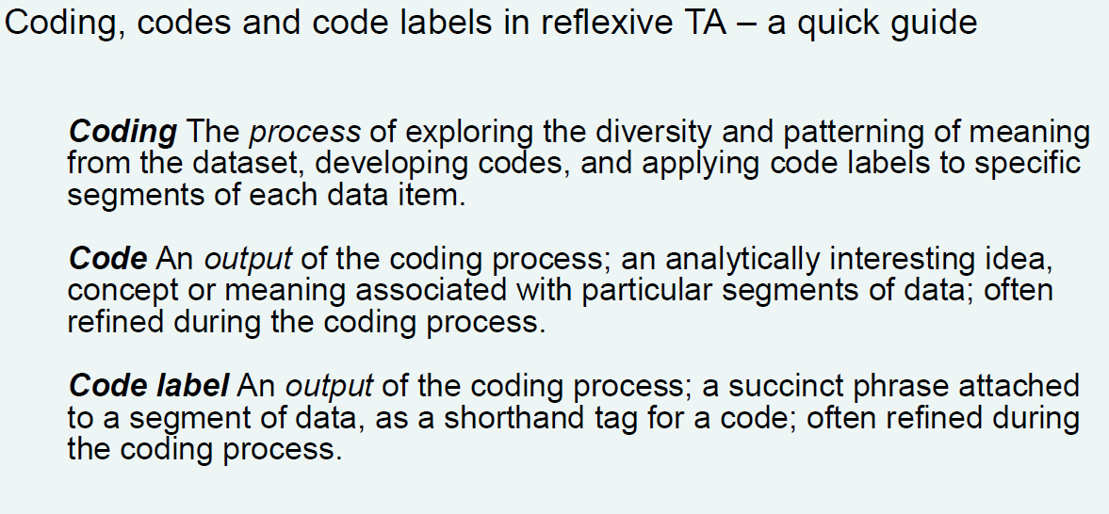
Phase 2: coding
Code is the smallest unit of your analysis. Your codes form the building blocks of your analysis; from these you will go on to develop your themes.
Your codes capture specific and particular meanings within the dataset, of relevance to your research question.
Code is more than a way to reduce down the detail of the data, it offers the interpretation based on the data.
Clarify “Coding”, “Code” and “Code label”

Slide 17
Coding is systematic
A systematic coding process is important for two reasons – insight and rigour.
Insight, because your analysis typically becomes deeper, more interesting, and less obvious through a repeated process of close engagements. Deepening your insights will help avoid the risk of foreclosing your analysis.
Rigour, because coding ensures a systematic engagement with meaning and patterning across the entire dataset. Systematic engagement also helps avoid the accusation of cherry-picking. This is the idea that qualitative analysts select ‘patterns’ in their data to fit their own predetermined ideas about what meanings are evident, through poor analytic practice and/or partial data engagement.

Slide 18
Coding is organic, evolving and subjective
Organic: Coding generates from the original dataset, without any list or set idea of what codes will used.
Evolving: Codes can evolve through the coding process, when you shift your understanding of meaning in relation to the dataste develops through coding.
Subjective: Coding is a process of interpretation or meaning-making, researcher subjectivity fuels this process. In the context of Big Q qualitative orientation, subjectivity is a strength rather than a weakness or source of “bias”(Nadar, 2014).

Slide 19
From semantic coding to latent coding
Reflexive TA can capture meaning from semantic to latent levels.
Semantic codes: Capture explicitly-expressed meaning, they often stay close to the language of participants or the overt meanings of data.
Latent codes: Focus on a deeper, more implicit meaning, sometimes quite abstracted from the obvious content of the data.
Whether to be semantic or latent reflects the spectrum of coding, it is not a single-side choice, but should be combined in coding process.

Slide 20
General guidelines for codes and code labels
The label you use for each code offers a shorthand for the broader idea you're working with. Goodcode labels are pithy and brief - they offer a quick in to what the code is about.
1) Don’t just copy the data
2) Identify the particular angle of the meaning
3) Indicate analytic take: A code label often contains some indication of your interpretative take-what you think is particularly important or interesting about this particular meaning.

Slide 21

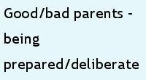





Example of coding
Data
Codes

Slide 22
Developing themes
in reflexive TA, with themes defined by meaning-unity and conceptual coherence, each theme has its owr
distinct central organising concept (Braun, Clarke, 8 Rance, 2014). Your analytic task is to explore the
In reflexive TA, with themes defined by meaning-unity and conceptual coherence, each theme has its own distinct central organising concept (Braun, Clarke, & Rance, 2014). This means that themes are grouped together based on shared meanings and concepts.
A topic summary is not a theme.
A central organising concept is the idea or meaning that unites a theme.
A contradiction in, or dichotomisation of, meaning can form the basis for a theme.
Notes:
Each theme has its own central organizing concept, which helps to further define and understand the theme. Think of it like a folder on your computer that has a clear label and contains related files - the organizing concept is like the label, and the files are like the data that fit into that theme.

Slide 23
Phase 3: Generating initial themes
This phase involves a range of processes of engaging with the data codes to explore areas where there is some similarity of meaning. Then clustering together the potentially connected codes (into candidate themes), and exploring these initial meaning patterns.
The initial way to explore patterned meaning is to consider all the codes, and explore whether there are any broad ideas that a number of different codes could be clustered around.

Slide 24
Generating initial themes
Your aim here is to generate a number of working provisional themes, and consider the story they allow you to tell about your dataset, to address your research question.
When analyzing qualitative data using the Thematic Analysis method, it's important to evaluate the initial themes. To do this, you can ask yourself three questions:
Is the theme coherent? In other words, does it have a clear central idea that connects all the data and codes together?
Does the theme capture something meaningful? Is it relevant and important to the research question or topic?
Does the theme have clear boundaries? Is it well-defined and distinct from other themes?
Notes:
keep in mind you are telling a story based on your research scope

Slide 25

Image shows cluster codes and develop candidate themes (but it can be also done by using software)

Slide 26
Using visual mapping for theme generation
A visual mapping technique - drawing thematic maps, either by hand or electronically is helpful Key to capture visual or figurative representation of potential themes, generate sub-themes, and relationships between themes.
Mapping provides a tool to start exploring possible layers within subthemes, your main task is identifying patterning at the theme level, and telling a rich, interpretative, contextualised story about these patterns.
More layers of theme level do not usually make a better analysis.

Slide 27
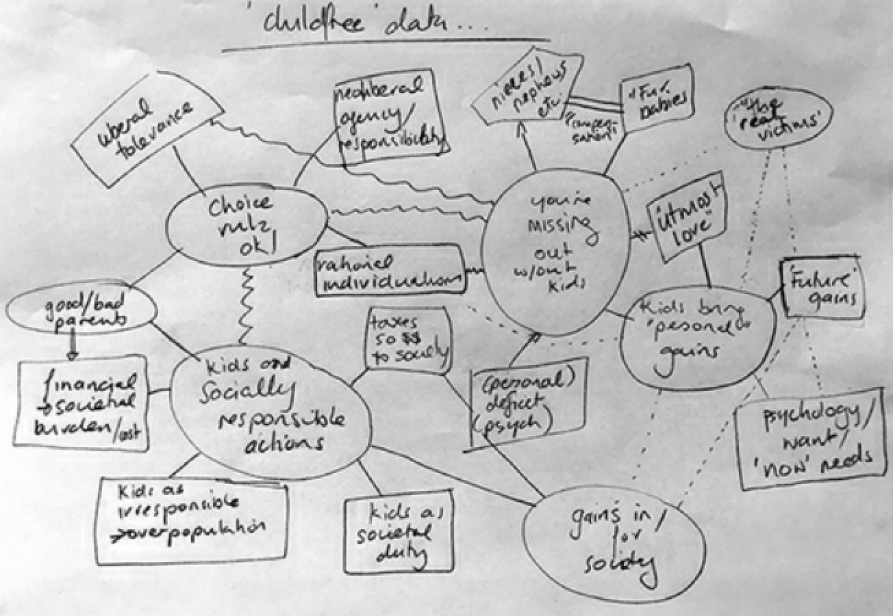
Image shows mapping of the patterns across different dataset

Slide 28
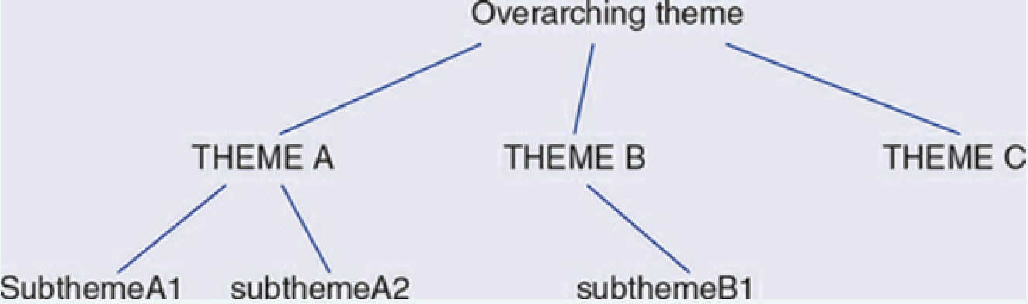
Image shows the layer of three types of theme
An overarching theme is like an umbrella concept or idea that embraces a number of themes. The point of an overarching theme is to demonstrate some broader conceptual idea that you identify as anchoring a number of themes together - in away that goes beyond the central organising concept of each.

Slide 29
Phase 4: Develop and review themes
in reflexive TA, with themes defined by meaning-unity and conceptual coherence, each theme has its owr
distinct central organising concept (Braun, Clarke, 8 Rance, 2014). Your analytic task is to explore the
This phase is partly about providing a validity check on the quality and scope of your candidate themes. But it's importantly also about developing the richness of your themes. You could evaluate your themes by these questions:
Can I identify boundaries of this theme?
Are there enough data to evidence this theme?
Are the data contained within each theme too diverse and wide-ranging?
Does this theme convey something important?

Slide 30
Theme development and revision with the full dataset
Coding moves you away from your dataset, and in initial theme generation you effectively work at two steps removed from the dataset. With theme generation, you're initially just looking at the code labels themselves. Each step of removal may lead to misremembering and decontextualisation. So, full, thorough and open engagement with the whole dataset is crucial.
Going backwards’ to develop TA is an important part of the process. Instead of representing “failure” it represents the researcher's commitment to producing a quality analysis.
Notes:
To ensure the validity of your themes in qualitative data analysis, it's important to engage fully with the entire dataset. Relying solely on code labels or preconceived notions of what the themes should be can lead to misremembering and loss of context. Take a thorough and open approach to analyzing the data to ensure accuracy.

Slide 31
Phase 5: Refining, defining and naming themes
in reflexive TA, with themes defined by meaning-unity and conceptual coherence, each theme has its owr
distinct central organising concept (Braun, Clarke, 8 Rance, 2014). Your analytic task is to explore the
Writing a theme definition - effectively an abstract for your theme - is a good test of the quality of your themes. A theme definition can be thought of as an abstract for your theme - outlining the scope, boundaries and core concept of the theme.
Naming theme: A good theme name will be informative, concise, and catchy. A good theme name is a short phrase, or perhaps a heading and subheading, that captures the essence of the theme and engages the reader.

Slide 32
Phase Six: Writing your TA report
Writing is a critical component of reflexive thematic analysis, where analysis is embedded in writing around the data. With TA, you produce analysis while writing. This is different from quantitative research where reporting often happens after analysis. “Themes shifted until the final manuscript was published” (Trainor & Bundon, 2020)

Slide 33
A gap model vs. argument model
Every good story needs a set-up, and an academic paper is no different
Two broad approaches to setting up an academic paper: the-dull-and-boring-facts versus the-curiosity-fuelled-questioning approaches
Establishing the gap model provides a rationale for your research question by summarizing what is known about a topic and any limitations or gaps in existing knowledge.
Making an argument model provides a rationale for your research question by situating and contextualizing it within existing knowledge, theory, and/or context
Notes:
Our preference is for the latter approach - making an argument model - but sometimes the former approach - establishing the gap model - is needed.
The establishing the gap model can produce unnecessary anxiety, and the making an argument model is more in line with reflexive TA and Big Q qualitative research.
Qualitative research provides a rich, contextualized examination of a topic that contributes to our existing understanding(s) of the issue and maybe even changes it.

Slide 34
Your Methodology Section
Purpose: Describe analytic process and key design choices for study.
Include discussion of recruitment/participants and ethics.
Explain and justify analytic choices and processes, including choice of TA.
Justification should connect to purpose of research and specific research question, as well as theoretical underpinnings and research design.
Rationale for using reflexive TA should be specific and demonstrate understanding of what it offers and allows for the study.
Notes:
Avoid generic strengths and instead explain why it is useful for the study in particular.
Locating TA theoretically involves acknowledging philosophical assumptions underpinning research.

Slide 35
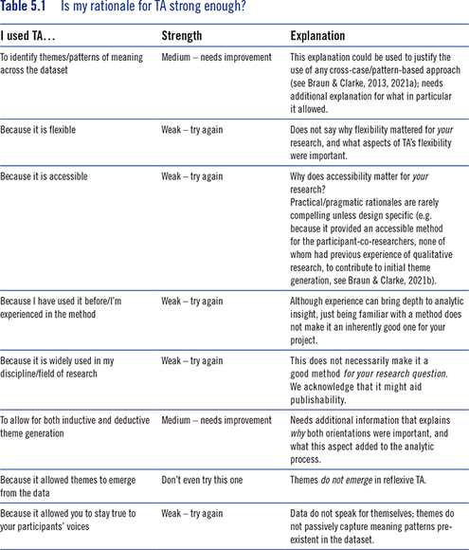

Slide 36
Introducing the Analysis
Give readers an introductory overview of the analysis.
Start with a brief summary of the themes to be discussed.
Use a summary paragraph, a simple list, a table, or even a thematic map.
Present each theme along with a brief summary of the central organizing concept and scope.

Slide 37
Structuring the Analysis Section
Combine data extracts and analytic narrative.
Loosely aim for a 50-50 balance of these two aspects.
More theoretical/deductive or latent/critical versions of TA might have a higher ratio of analytic narrative to data extracts.
The data extracts provide foundational validation for your analytic claims.
Use a qualitative reporting model where the ‘results’ and ‘discussion’ sections are combined.

Slide 38
Tips for Selecting Data Extracts
The inclusion of data extracts in TA serves two purposes: evidencing your analytic claims and allowing readers to judge the fit between data and interpretations.
Select a number of extracts (per theme) that most strongly and clearly evidence your analytic claims, usually one to three extracts for each key point, depending on your purpose.
Select vivid examples, but aim to include the most compelling extracts.
Avoid over-quoting from one particular source, and select extracts across the range of data items.
Use clear and concise extracts to illustrate analytic claims, and longer extracts when treating data analytically.
Use a range of quotations for each theme, including ones that evidence the central organising concept and others that illustrate different facets of the theme’s expression.
Avoid repeating extracts, except in exceptional circumstances.
Edit out unnecessary details, but do not remove text that contradicts the analytic claim you are making.
Clarify and contextualise extracts where necessary.

Slide 39
Traps to Avoid when Reporting Your Analysis in Reflexive TA
Simply paraphrasing the data without interpretation. Remember that data do not speak for themselves; you speak for data!
Not analyzing the data. Even if you use multiple and often short extracts of data, analysis should still always move you beyond the data.
Evidence of arguing with the data. Your role isn't to determine whether participants or data are right or wrong, but to explain what is important and interesting about what they are saying.
Extracts that don't convincingly demonstrate your analytic claims. Ensure that the evidence for your analytic claim is not overinterpreted or suggests an alternative interpretation.
Remember, with reflexive TA, analysis effectively uses data to make a point. Your analysis should be driven by the question "so what?" What is relevant or useful here in addressing my question?

Slide 40
Writing up Qualitative Analysis
Misperceptions about TA and qualitative research often lead to universalizing descriptions. Thick description refers to richly contextualized and interpretative analytic narratives that help readers understand the data’s significance and assess the interpretation. It is a useful concept to contextualize data extracts in reflexive TA.
Consider the theme order, as it helps in telling the strongest story about the analysis. Questions like logical flow, centrality of a theme, and connections between themes can guide the order.
Theme frequency is not encouraged in reflexive TA. Reporting the frequency of themes is not consistent with a Big Q qualitative framework, and it is a remnant of quantification envy that buys into the logic of more is better. The focus should be on the richness of analysis rather than the number of responses.

Slide 41
Should I claim generalisability in reporting my TA?
The concept of generalisability is often associated with statistical or empirical research
Many published TA papers apologise for lack of generalisability
Qualitative research apologising for lack of statistical generalisability is problematic as it evokes certain norms and ideals around knowledge
Other forms of generalisability have been proposed, including intersectional and flexible generalisability
Transferability is another criterion used to talk about research inferences beyond the boundaries of the dataset
Qualitative generalisability is related to the principles of qualitative research.
TA researchers should consider the relevance of generalisability to their study and choose a form that aligns with their research goals and values.

Slide 42
Type of generalisability | Brief description | Relevance to reflexive TA
Intersectional generalisability (Fine, Tuck, & Zeller-Berkman, 2008) | Work that records the particulars of historically oppressed and colonized peoples/communities and their social movements of resistance, as well as work that tracks patterns across nations, communities, homes, and bodies to theorize the arteries of oppression and colonialism. | Applicable to reflexive TA with a concern for social justice, and particularly to the use of TA within community-based and participatory designs. Also applicable to experiential TA research that seeks to explore the lived experience of socially marginalized groups.
Flexible generalisability (Goodman, 2008) | Discursive analyses are generalizable to the extent that they can show how a particular discursive strategy will often produce the same results. | Potentially applicable to constructionist and critical forms of reflexive TA, and particularly when combined with discursive approaches.
Idiographic (Sandelowski, 2004), analytical (Chenail, 2010; Lewis, Ritchie, Ormston, & Morrell, 2014; Polit & Beck, 2010; Simons, 2014), and vertical (Stephens, 1982) generalisability | Building a deep interpretative and conceptually-oriented analysis that can contribute to wider knowledge. This type of generalisability occurs through conceptual or theoretical generalisability. | Applicable to reflexive TA that is richly interpretative, particularly to more deductive/theoretical forms of reflexive TA.
Transferability; inferential (Lewis et al., 2014) or case-to-case generalisation (Chenail, 2010) | Describes research where the specific context, participants, settings and circumstances of the study are described in detail so the reader can evaluate the potential for applying the analysis to other contexts and settings. | Potentially applicable to all forms of reflexive TA.
Naturalistic (Stake, 1995) or representational (Lewis et al., 2014) generalisability | When the research resonates with the reader’s experiences and/or they recognise similarities between the analysis and other research. | Potentially applicable to all forms of reflexive TA. 'Resonating with the reader’s personal experience' is likely more applicable to experiential orientations.

Slide 43
Drawing Conclusions
Conclusions are important to tell the reader why your analysis matters.
You can draw conclusions in relation to six different domains:
Data and analysis
Existing scholarship and/or the discipline you’re working in
Method or methodology
Theory
Practice
Wider societal context

